Slide 1
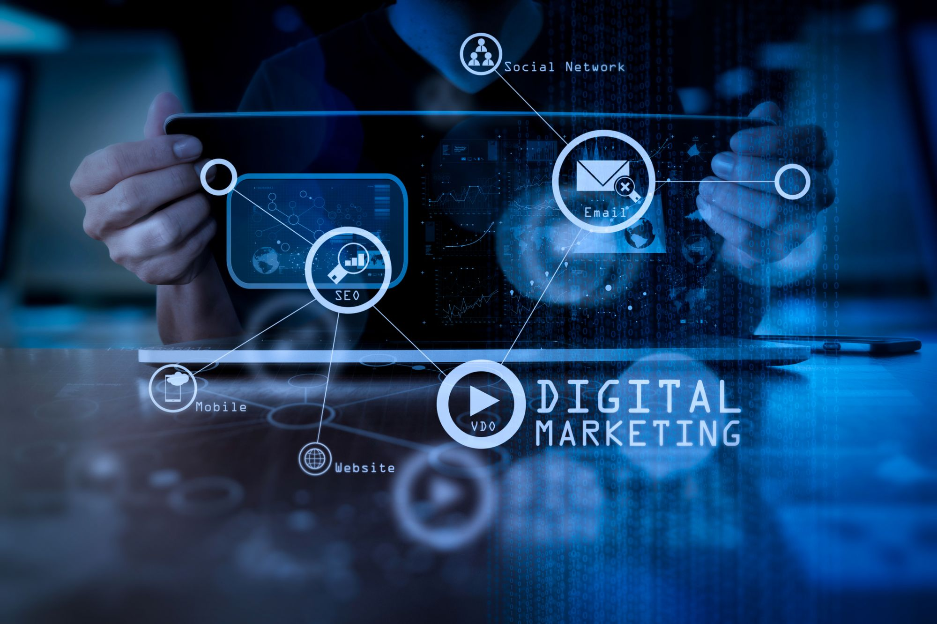

Slide 2
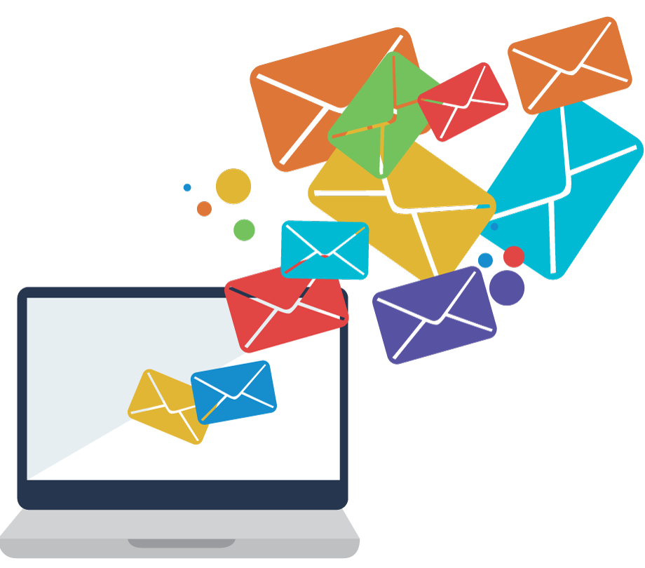
Email Marketing Fundamentals

Slide 3
Email marketing is the process of sending targeted emails to a group of subscribers to promote products, share news, or build relationships
What is Email Marketing?
Definition
Purpose
Drive engagement
Increase sales
Nurture customer relationships

Slide 4
Importance of Email Marketing
Direct Communication
Establishes a direct line to customers’ inboxes
High ROI
For every $1 spent, email marketing has an average ROI of $42
Customer Retention
Keeps your brand top-of-mind and encourages repeat purchases
Personalization
Tailor messages based on user behavior and preferences for better engagement

Slide 5
Key Components of Email Marketing
Email List
A database of subscribers who have opted in to receive communications
Email Content
Engaging and valuable content that resonates with your audience
Call to Action (CTA)
Clear instructions encouraging recipients to take a specific action (e.g., shop, sign up)
Analytics
Tracking metrics to measure success and improve future campaigns

Slide 6
Building and Managing an Email List
Opt-In Methods
Use sign-up forms on your website, social media, and events to collect email addresses
Incentives
Offer discounts, free resources, or exclusive content to encourage sign-ups
Segmentation
Group subscribers based on interests, demographics, or behavior for targeted messaging
Maintaining the List
Regularly clean your email list to remove inactive subscribers

Slide 7
Types of Email Campaigns
Newsletters
Regular updates about your brand, products, or industry news
Promotional Emails
Special offers, discounts, and product launches to encourage sales
Transactional Emails
Order confirmations, shipping notifications, and receipts
Re-engagement Emails
Targeting inactive subscribers with special offers or updates to win them back

Slide 8
Basics of Email Marketing Tools
Popular Tools
MailChimp
User-friendly interface, automation features, and analytics
Constant Contact
Great for small businesses with templates and support
SendinBlue
Email marketing and SMS solutions with robust automation
Key Features to Look For
Drag-and-drop email builders, analytics, automation capabilities, and A/B testing

Slide 9
Best Practices for Email Marketing
Craft Compelling Subject Lines
Grab attention and encourage opens (keep it concise and relevant)
Design for Mobile
Ensure emails are mobile-friendly for better readability
Personalize Your Emails
Use the recipient's name and tailor content to their interests
Test and Analyze
A/B test different elements and analyze metrics to optimize future campaigns

Slide 10
Measuring Success in Email Marketing
Key Metrics
Open Rate
Percentage of recipients who opened your email
Click-Through Rate (CTR)
Percentage of recipients who clicked on a link
Conversion Rate
Percentage of recipients who took the desired action
Unsubscribe Rate
Percentage of subscribers who opted out of your list

Slide 11
Discussion Questions
What types of emails do you find most engaging? Why?
(Encourage students to think about email campaigns that caught their attention)
Have you ever unsubscribed from an email list? What was the reason?
(Encourage reflection on what turns users off from email campaigns)

Slide 12


Slide 13


